Slide 1



Data Lead
Netflix recommandation engine
ABBAS Billel

Slide 2

Project goals
Use an artificial intelligence library to create a recommendation engine → « FASTAPI »
Set up an infrastructure to process real-time user interactions on the platform → « Kafka - Producer »
Automatically provide real-time recommendations as soon as the user finishes watching a movie → « Kafka - Consumer »
Project link : https://app.jedha.co/course/final-projects-l/netflix-automation-engine-l

Slide 3
Demo App

Slide 4
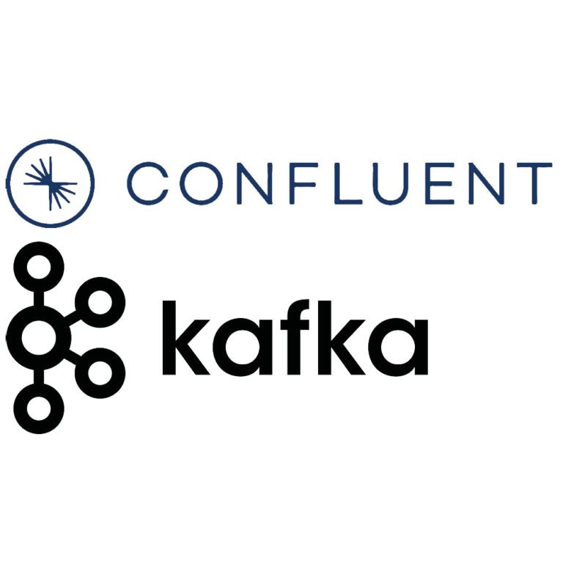

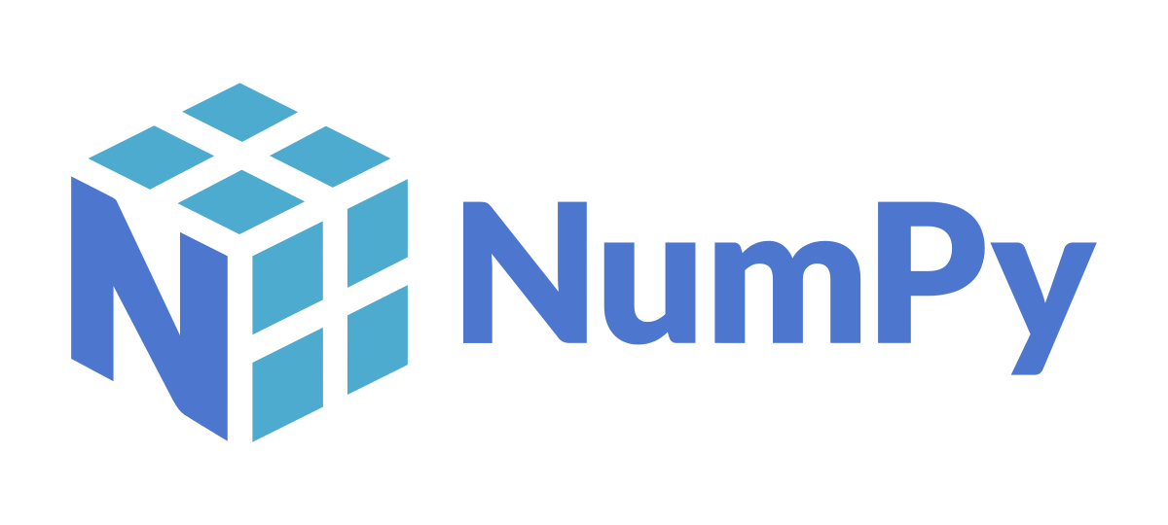

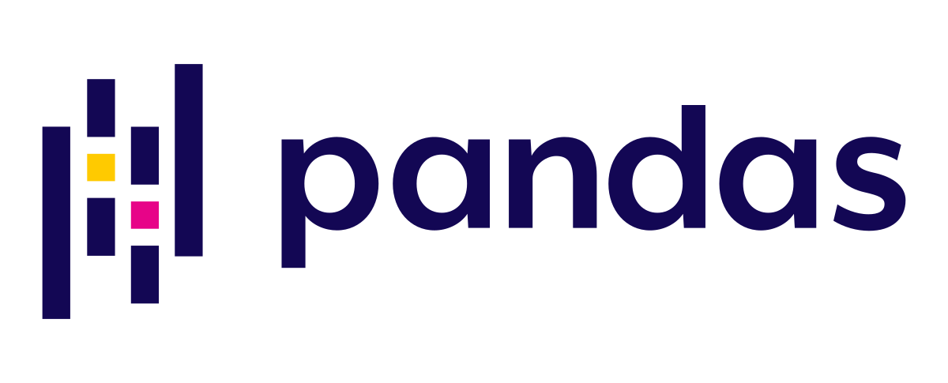


Global diagram
Preprocessing data & Machine Learning
Creating FASTAPI
Kafka (Producer + Consumer)
Database
Dag - Airflow

Slide 5
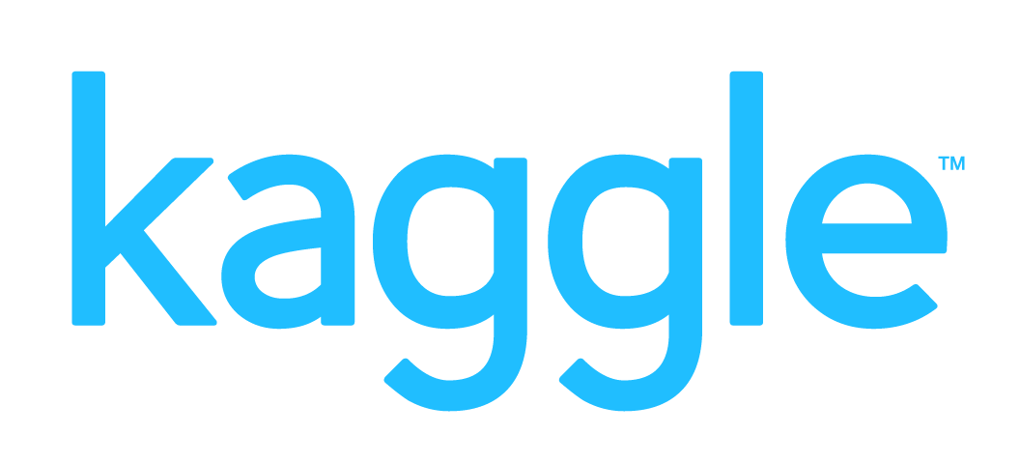



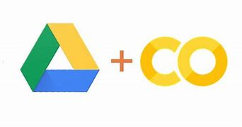


Preprocessing data & Machine Learning Model
Step 1 = Clean Data, Feature Engineering
Step 2 = machine learning model
4 * ~500M
Data_cleanead.csv
1.2Go
Data_cleanead.csv
1.2Go
model.pkl
550M
Train an SVD model capable of taking the user identifier (cust_id) as input and predicting ratings for movies that the user has not yet watched.
Notes:
Explication du modèle SVD → Modèle type pour les problématiques de recommandation

Slide 6
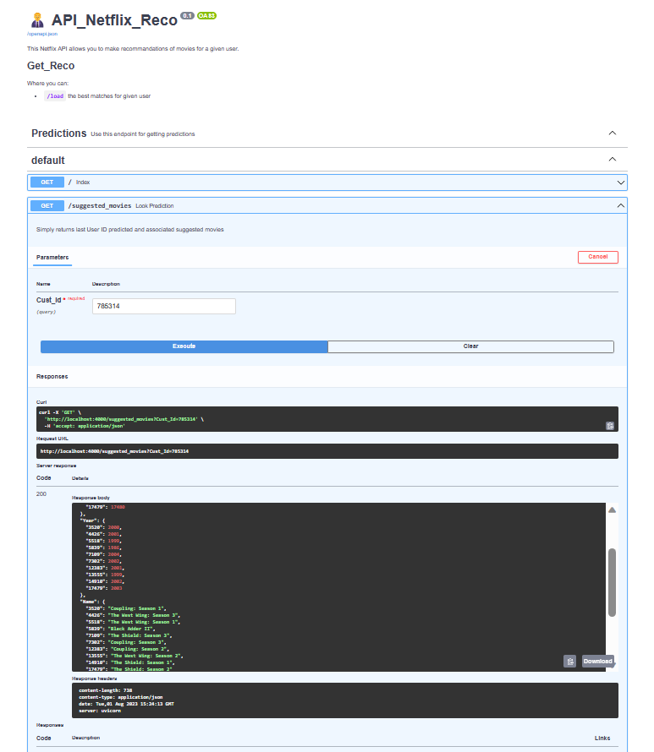
FASTAPI
http://localhost:4000/docs#/
model.pkl
app.py
data_reco.csv
For each customer identifier as input, the FastAPI predicts the top 10 movies based on the estimated score, in ascending order

Slide 7











Kafka - Confluent
Bucket S3
Generate real-time data
Retrieve live data every 20 sec
Call API_netflix_reco
Consume live data
Store the data in PostgreSQL
API Jedha Netflix
Producer
Consumer

Slide 8

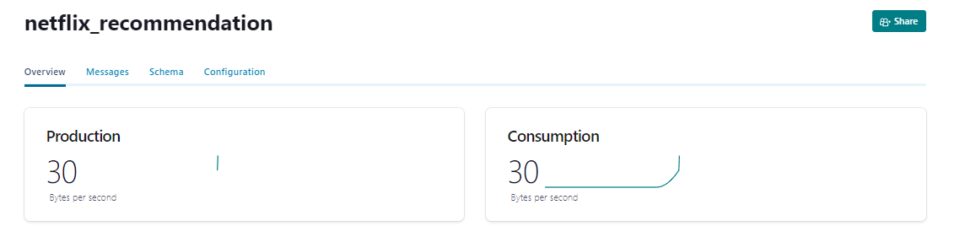
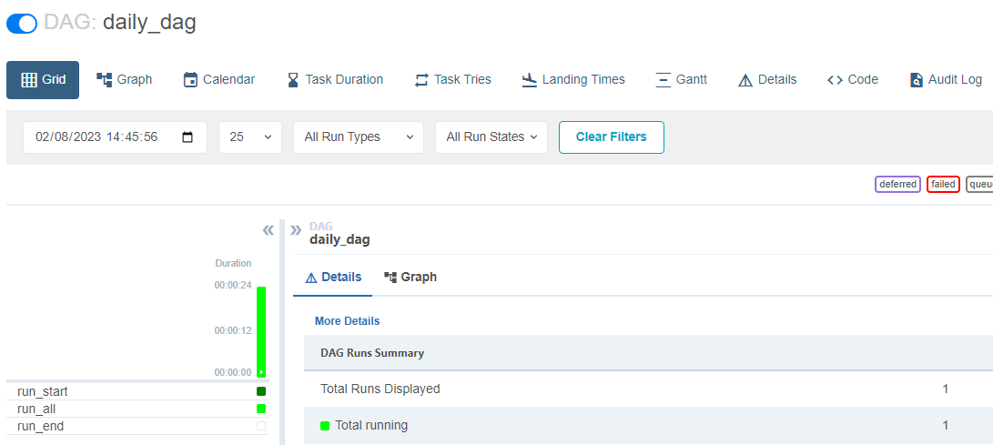
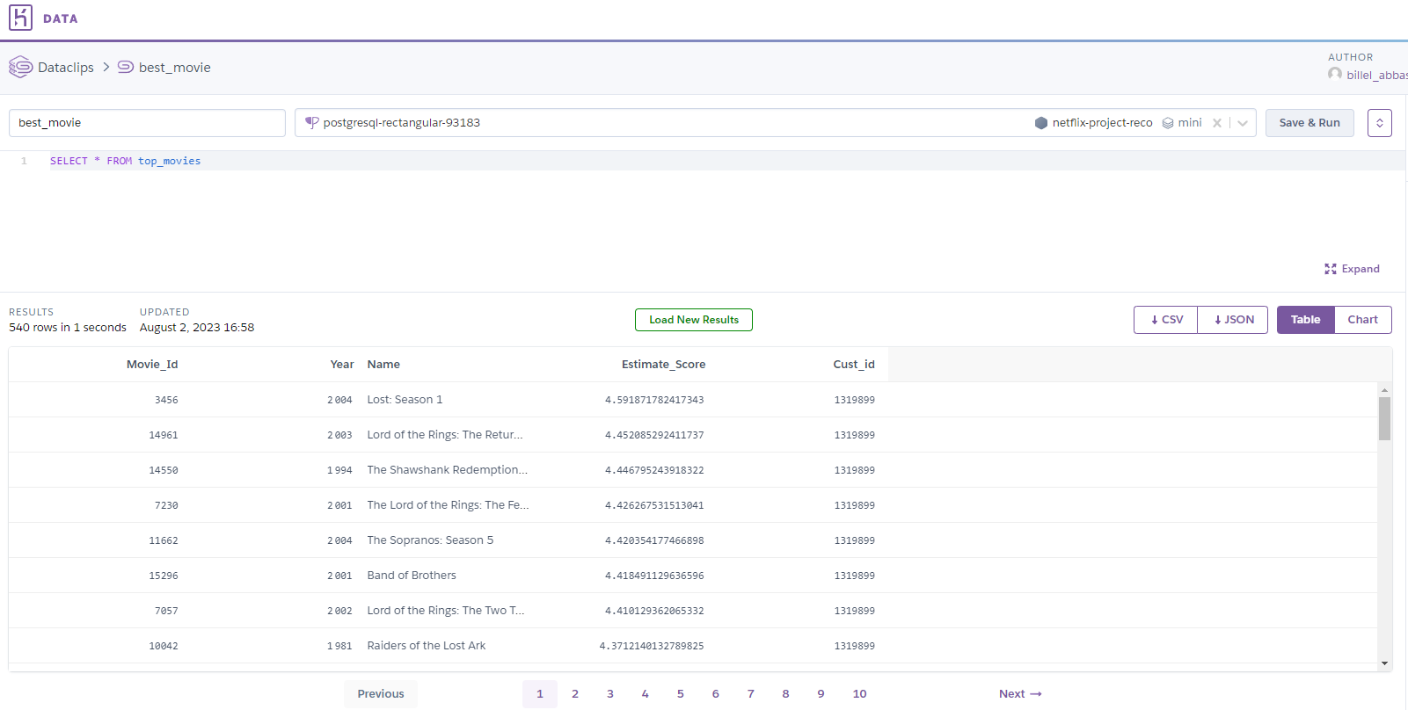
DAG Airflow
airflow webserver -p 8080
airflow scheduler
bash_command
Launch « daily_dag »
python3 ../dags/FASTAPI/app.py
python3 ../dags/kafka_netflix/producer.py
python3 ../dags/kafka_netflix/consumer.py
bucket S3

Slide 9

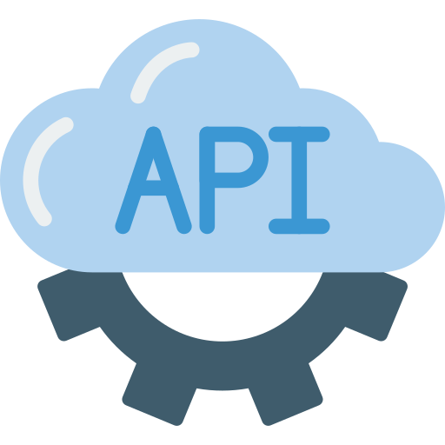
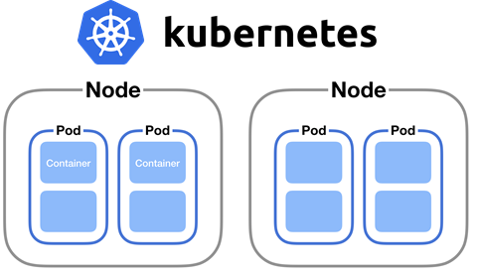

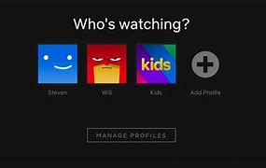

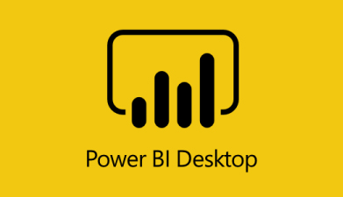

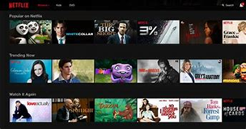
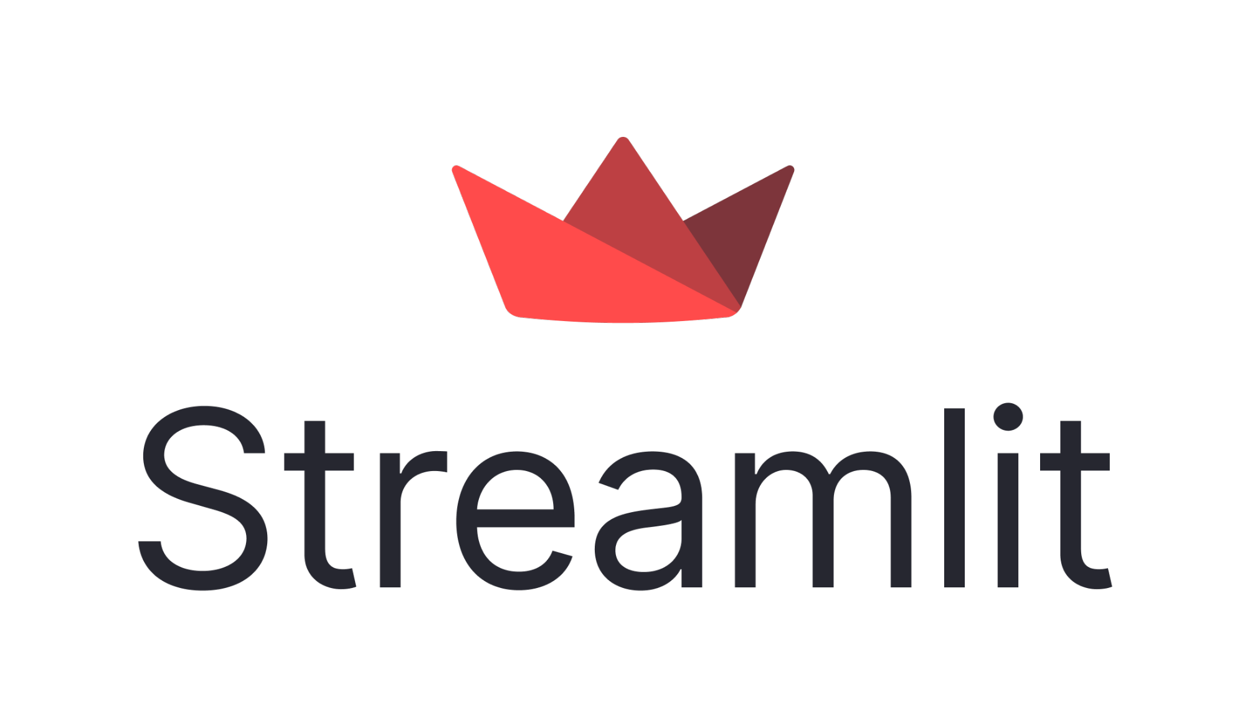

What’s next ?
Database
Datalake
Dataviz
New User id

Slide 10

Any questions ?

